Slide 1
Capstone Project
Play Store App Reviews

Slide 2
Team Members Vishal Lanjulkar Gayatri Surapaneni

Slide 3
Introduction
In today’s era, the Google Play Store is the largest and most popular android app store. It is flooded with millions of applications and it provides wide collection of data on features like ratings, price and number of downloads and apps description. Many apps are being developed as apps are easy to create and its lucrative. But its important for developers to know which apps are loved by customers and are trending in market so that he develop only those apps and also there is a high competition between app providers producing similar applications. Analysing customer needs is one of the bizarre tasks in the business world today. Hence proposing analyse data to developer that what customer is likely to download, which category got the maximum downloads this all plays a crucial role in app development. Generally, customers download apps depending on number of downloads, positive reviews, negative reviews, ratings and comments. So, in this project we are going to help the users by categorizing positive, negative and neutral reviews and comments of the particular. we are going to help developer by analyzing the desire of the customer through the reviews provided in the feedback section and apps trend in the market to help the organization & developers. Also provide an idea about app that managed to get maximum and minimum number of downloads and predicting the category of apps that is most likely to be downloaded in the coming years.

Slide 4
Analyze the Data
Analyzing the data to find the key factors for success and engagement of Apps.
By applying Pandas , Numpy and Data visualization.
First we have to define questions
Create models to solve questions

Slide 5
Data Structure
Dataset has 13 columns which are the parameters of the apps. Let's look at each column –
App - Name of the app
Category - type of the app
Rating - rated by the users out of 5
Reviews - number of reviews given by users
Size - size of the app in mb

Slide 6
Data Structure
Installs - number of instalations of app
Type - free or paid
Price - price in $ of paid apps
Content Rating - rating for which users can use app
Genres - category or type of app
Last Updated - date on which app updated last time
Current Ver - current version of the app
Android Ver - android version which app supports

Slide 7
Data Summary
In Play stores Apps will be downloaded
Here we have the data of 10k apps
Each app has the data of to which category it belongs .
The average rating on the scale of 5
How many people installed it
How many reviews it got
The size of the App
To which version of android it is suitable
Last updation and its version

Slide 8
Data Processing
At first we have to clear the data by removing null values and changing the data types in required columns.
Next we have to do Exploratory data analysis for modified data
Next we have to create the model and analyze the data as required

Slide 9
Analyzing and treating missing values
Missing values are caused by incomplete data. It is important to handle missing values effectively, as they can lead to inaccurate inferences and conclusions.
Let's start by analyzing variables with missing values
.
Rating 1474
Type 1
Content Rating 1
Current Version 8
Android Version 3
Looking at number of missing values above, we notice that the column Rating has a lot of missing values in it. The other columns do have missing values but they are less than 10

Slide 10
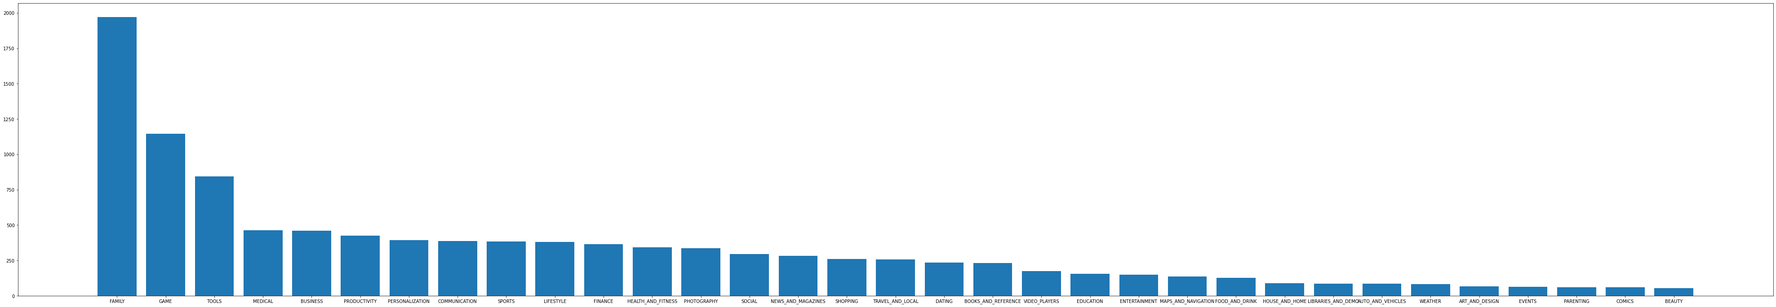
Analyzing Categories
Analyzing Categories

Slide 11
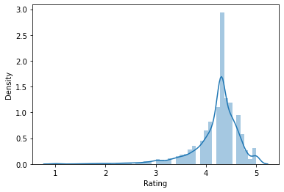
Avg total Rating
Rating

Slide 12
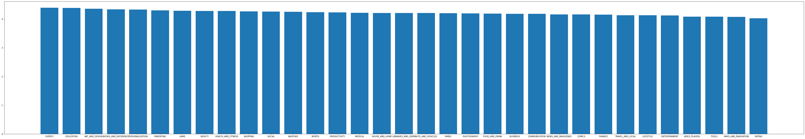
Avg Rating for each Category

Slide 13
User Reviews
In the User reviews file we have some data on positive , negative, neutral reviews of some apps
Duolingo: Learn Languages Free has highest positive reviews followed by Calorie Counter myfitness bar and calorie counter my net diary
Angry birds classic had more negative reviews.

Slide 14
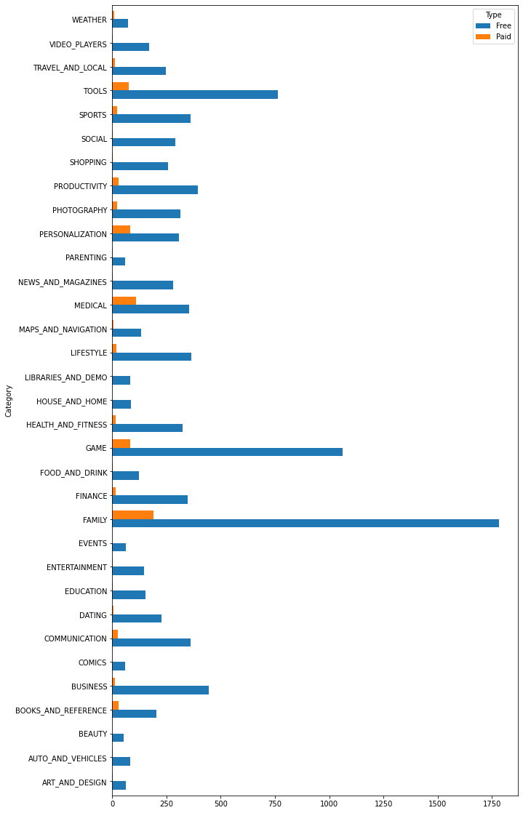
Type of Apps

Slide 15
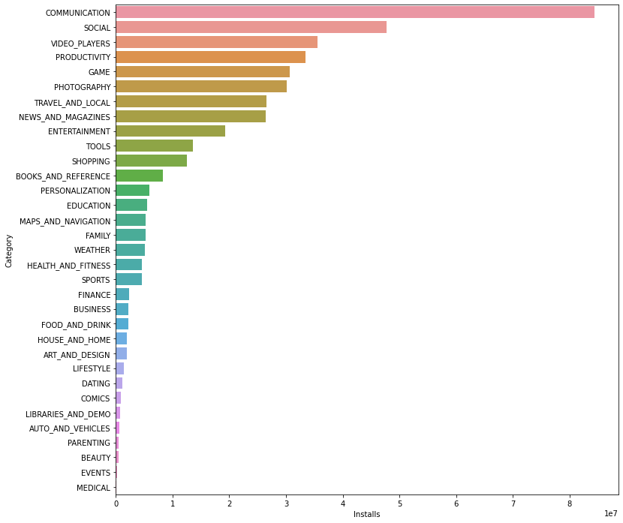
Installations

Slide 16
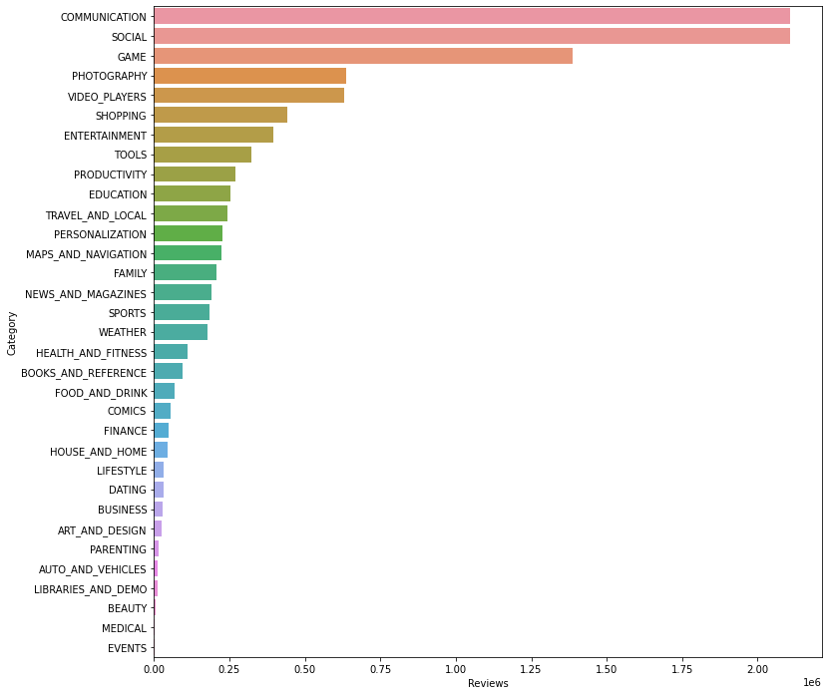
Reviews

Slide 17
Summary
Key factors for success and engagement of apps relays on
Number of installations
Reviews
Ratings
These are the factors that effect the success of apps

